Slide 1

Sophos Central Presentation
Kendrick Gaines

Slide 2
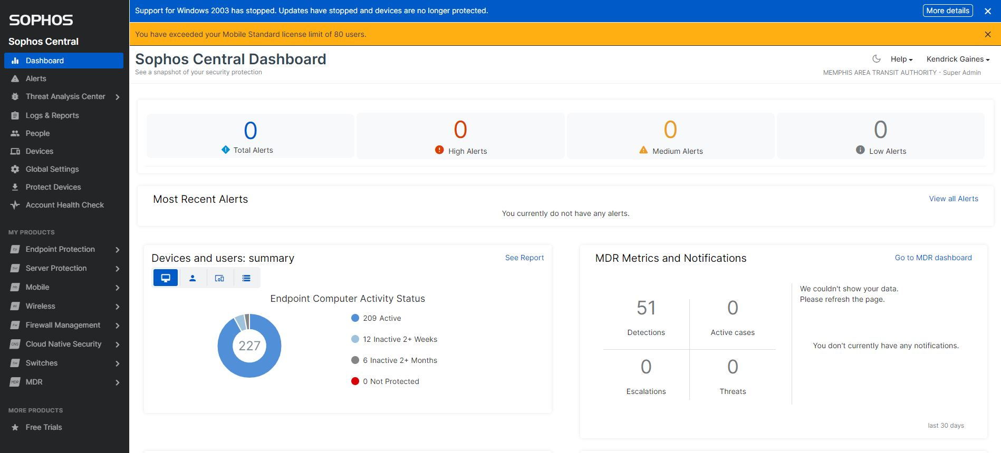
Sophos Dashboard
The Dashboard tab displays the alerts in category High Medium and low. A High alert must be investigated first and fast. It could be Sophos on endpoint needs updating or not reporting. Or it could be a virus of a folder or document. Medium alert could be PUA (Potentially Unwanted Application) Some of these alert are legit application that needs to be on the exclude list. So, Sophos won’t block it. Low Alerts could be Sophos hasn’t seen the device in a long time.

Slide 3
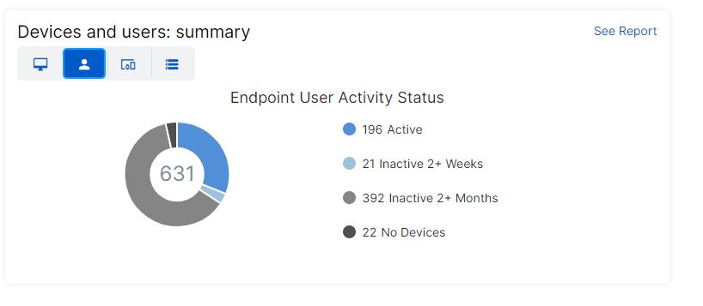
Devices and users: summary
Click the users tab indicate by the orange arrow and it shows active, inactive 2+ weeks, inactive 2+mouths and no device. User that has Sophos installed on their device and login regularly it will show activity. Users that have not been login for 2weeks or 2months it will show inactive. Lastly No Devices will show users with no devices. All the users are tied to active directory and other databases.
Click the See Report Tab refer to Logs & Reports Slide

Slide 4
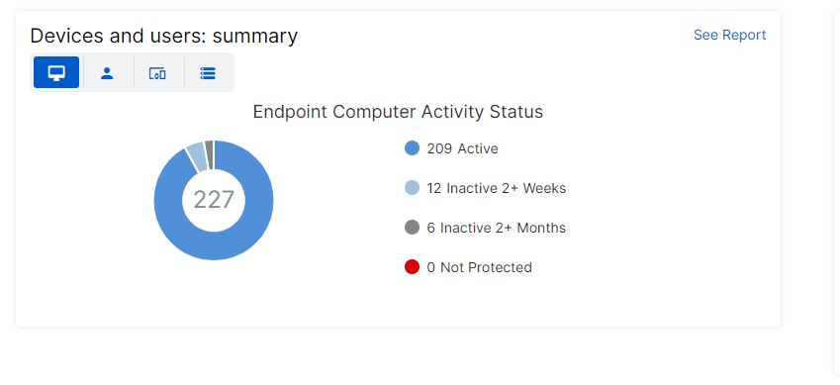
Devices and users: summary
Click the device tab indicate by the orange arrow and it shows active, inactive 2+ weeks, inactive 2+mouths and not protected. Devices that has Sophos installed on their device and it will report back to Sophos Central for updates. If it doesn’t it will show inactive. The red dot indicates not protected meaning Sophos is not installed.
Click the See Report Tab refer to Logs & Reports Slide

Slide 5
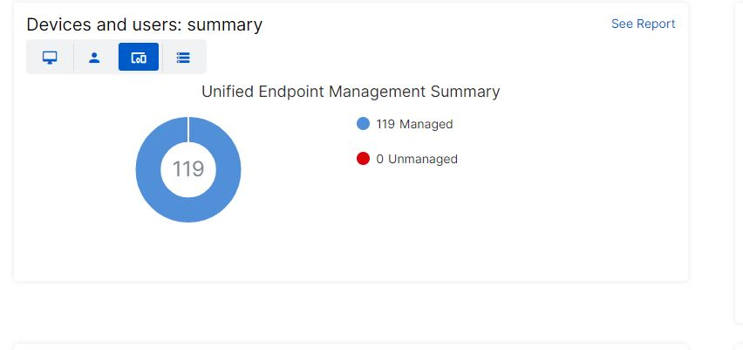
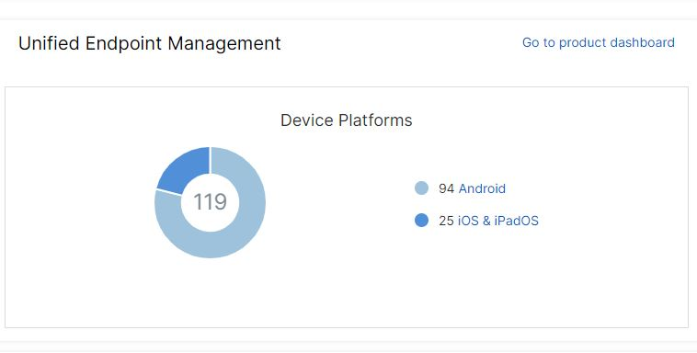
Click the phone tab indicate by the orange arrow and it shows Managed or Unmanaged Unified Endpoint.
The blue dot means Sophos is installed and the red dot means Sophos is not installed. The next image is showing what kind of device Sophos is installed on it.
Click the See Report Tab refer to Logs & Reports Slide
Devices and users: summary

Slide 6
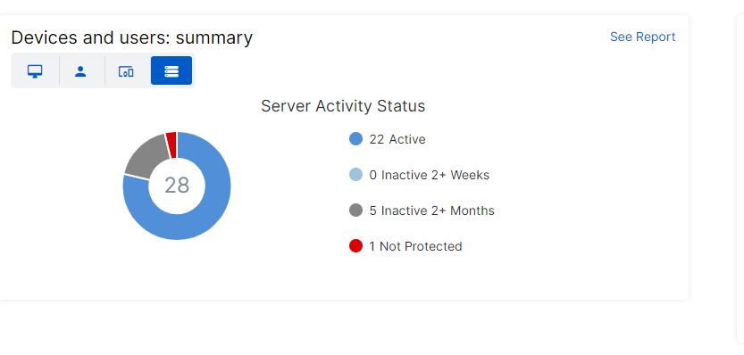
Devices and users: summary
Click the server tab indicate by the orange arrow and it shows active, inactive 2+ weeks, inactive 2+mouths and not protected. Devices that has Sophos installed on their device and it will report back to Sophos Central for updates. If it doesn’t it will show inactive. The red dot indicates not protected meaning Sophos is not installed.
Click the See Report Tab refer to Logs & Reports Slide

Slide 7
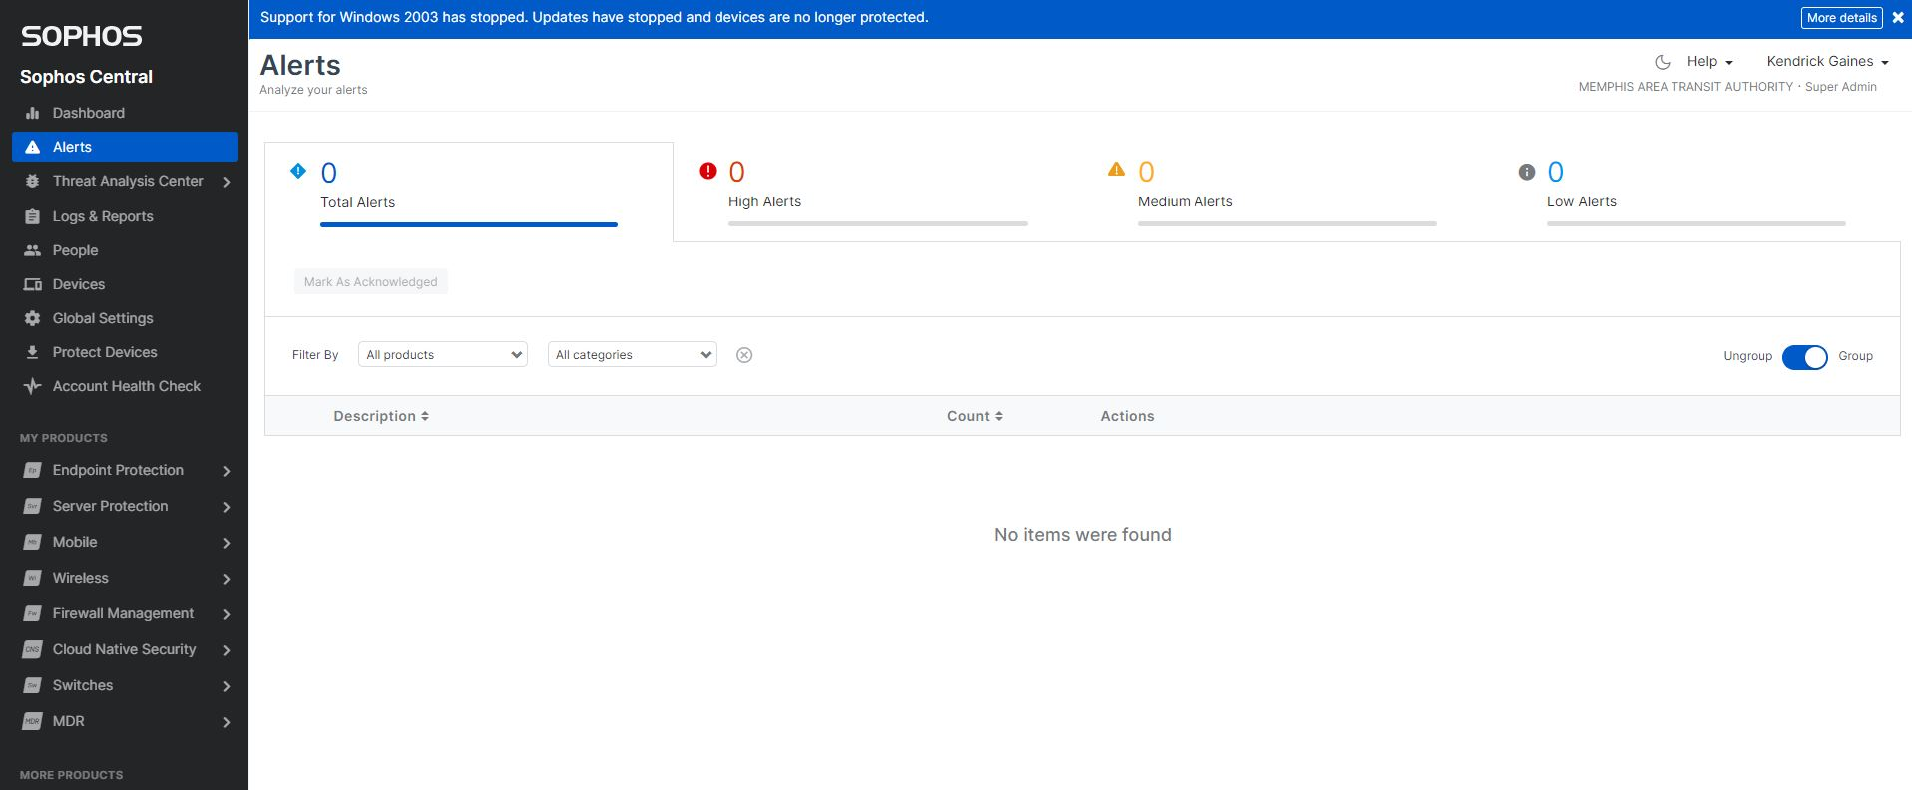
Sophos Central Alerts
Alerts are measured by High, Medium, Low and total amount. If an alert is form, it will display under description and display the action Sophos took to protect the device. It will also notify the admin if user interaction is needed to fix the issue or issues.

Slide 8
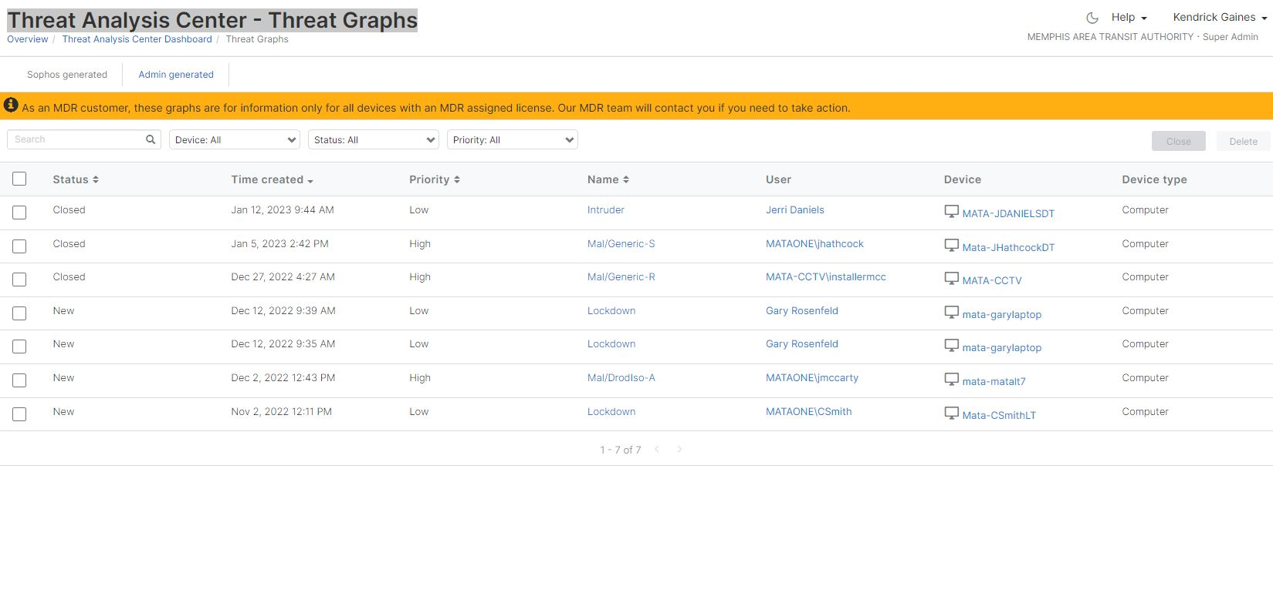
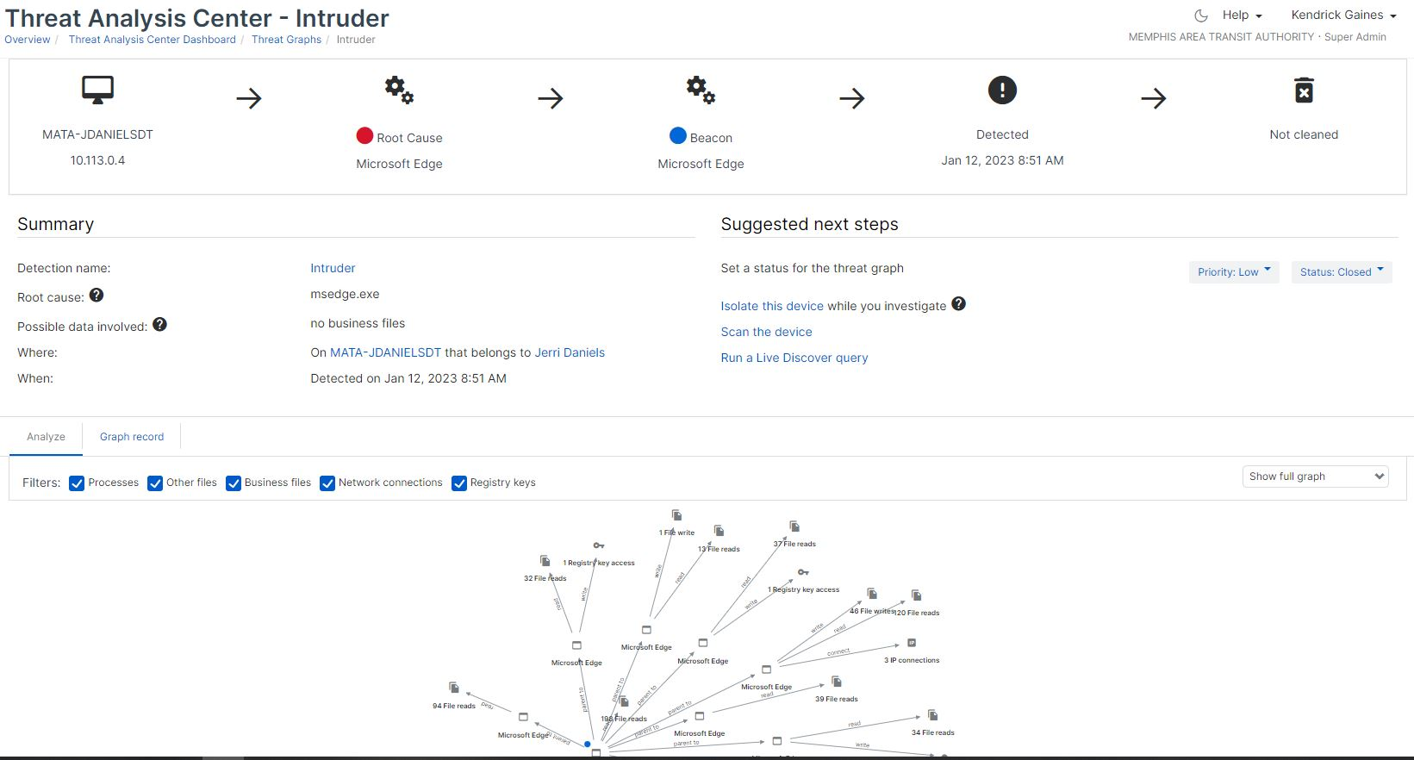

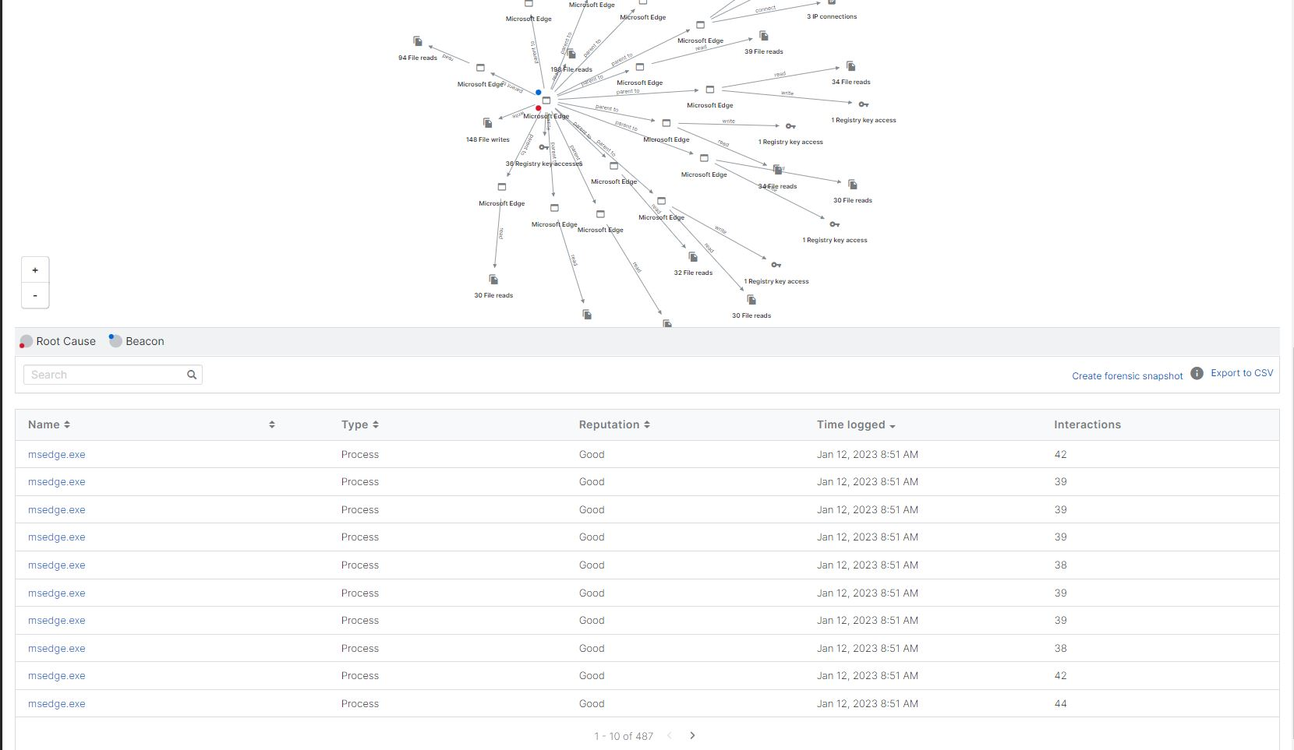
Threat Analysis Center - Threat Graphs
The threat graph is a list of threats that Sophos generated and
Rated from high to low. It give you the option to close ticket here after investigation. Click on one of the name in the cell and it will open a new page as show on the left. I click intruder.
On the threat analysis center intruder page, you can isolate the device, scan the device and run a live query to further investigate the root cause. Below is a graph and it show how the application cause the error. You can filter the graph by checking the box beside each: processes, other files, business files, network connections and registry keys to get a better view of the root cause trace.

Slide 9
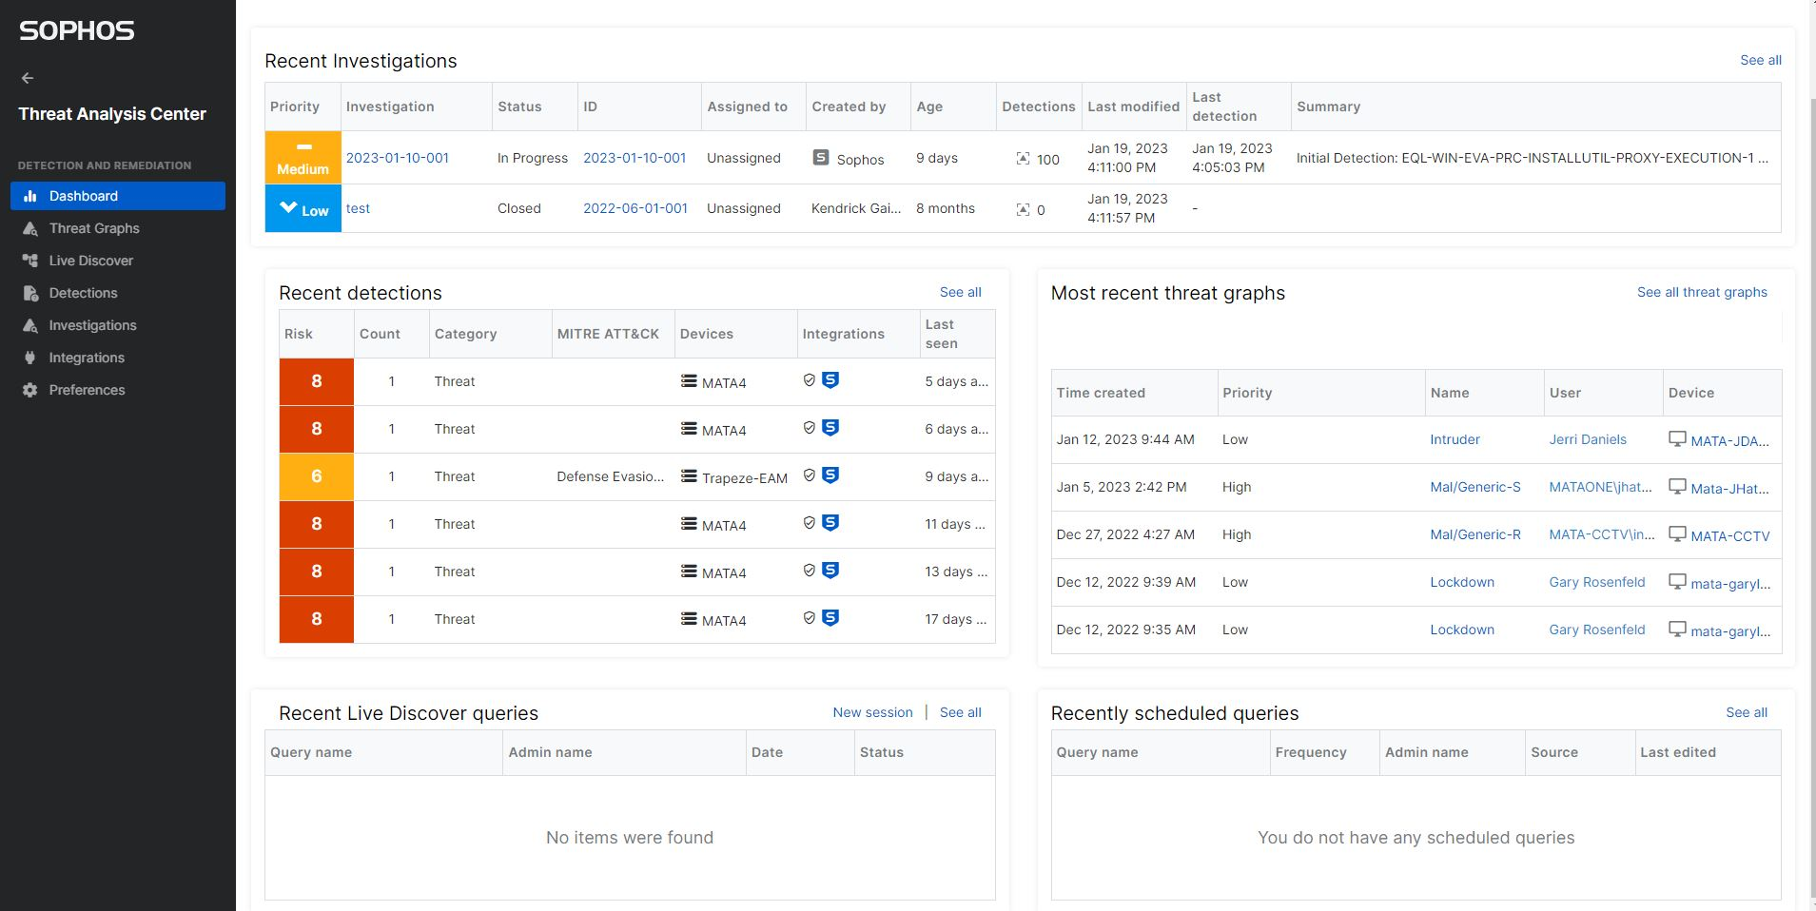
Threat Analysis Center - Investigations
The dashboard consist of five(5) different category to identify and rate the threat. The investigations tab show investigations that Sophos has created to solve the issue with the machine, or an administrator can create an investigation to solve and investigate deeper to find the root cause. Click see all to list investigations and they can be export or sort by risk rate.

Slide 10
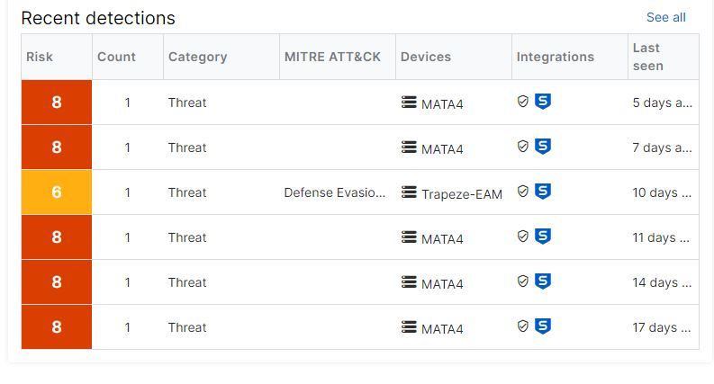
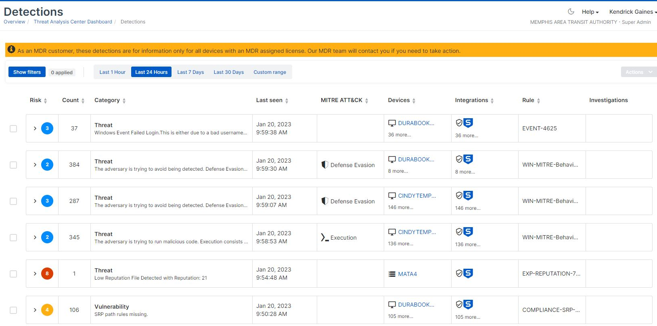
Threat Analysis Center - Detections
Detections tab is a preview of threats that happen over
The last 30 days. It shows what machine and the risk
Level of the threat from 1-10. Click see all and it takes
You to the bottom slide. Where you can investigate further.
If the MDR feature is active on the customer account Sophos
Will solve the risk and solve it for the user. IT will
Also notify the administrator. MDR means: An MDR solution provides access to both the tools and security expertise that an organization needs to protect itself against cyber threats. An MDR provider will offer round-the-clock network monitoring and incident investigation and response.
The see all tab at the bottom will give you the option to filter detections 1hour, last 24hours, last 7days and last30 days. You can even create a custom range to display.

Slide 11
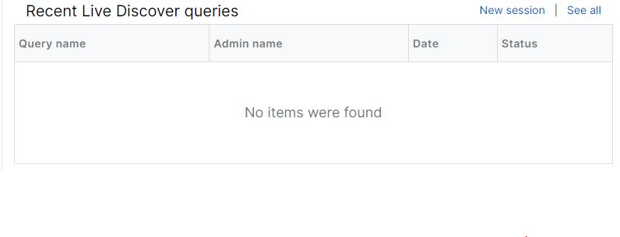
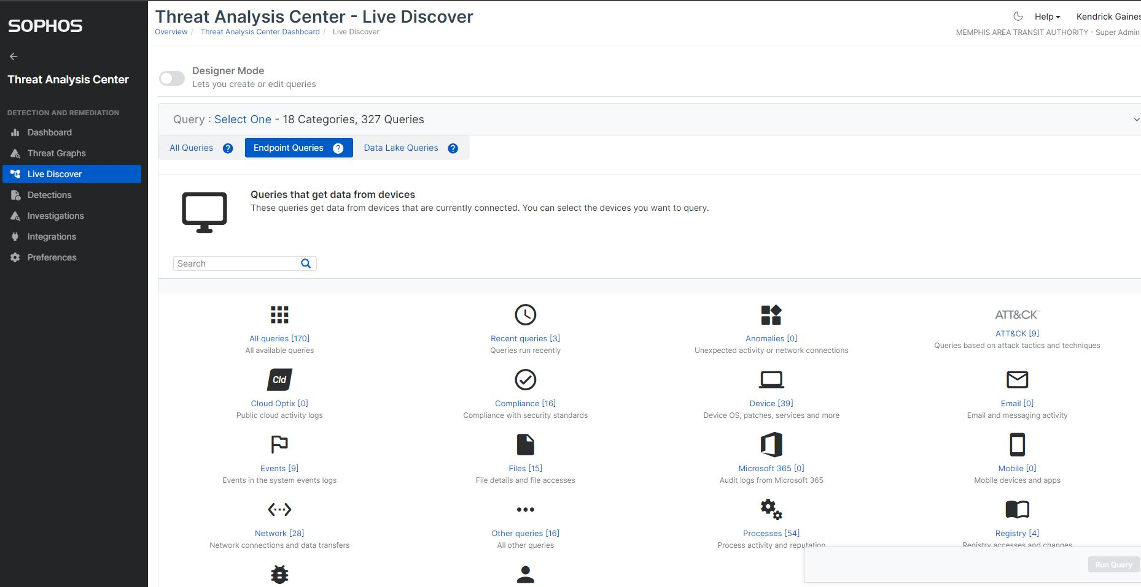
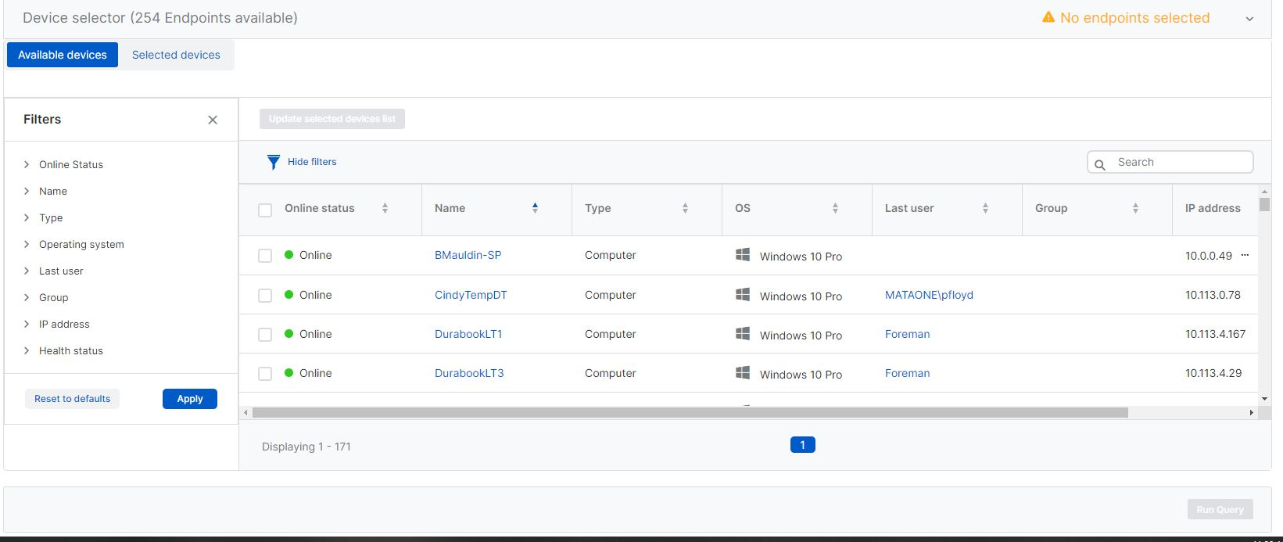
Threat Analysis Center - Live Discover
Recent live discover on the home page show queries that have been perform in the environment. Click see all to get a better view. Click new session and the threat analysis center display appears where you can create different queries. By choosing endpoint or data lake you get different options to build a query against an endpoint that you select from the bottom slide. Then click run.

Slide 12
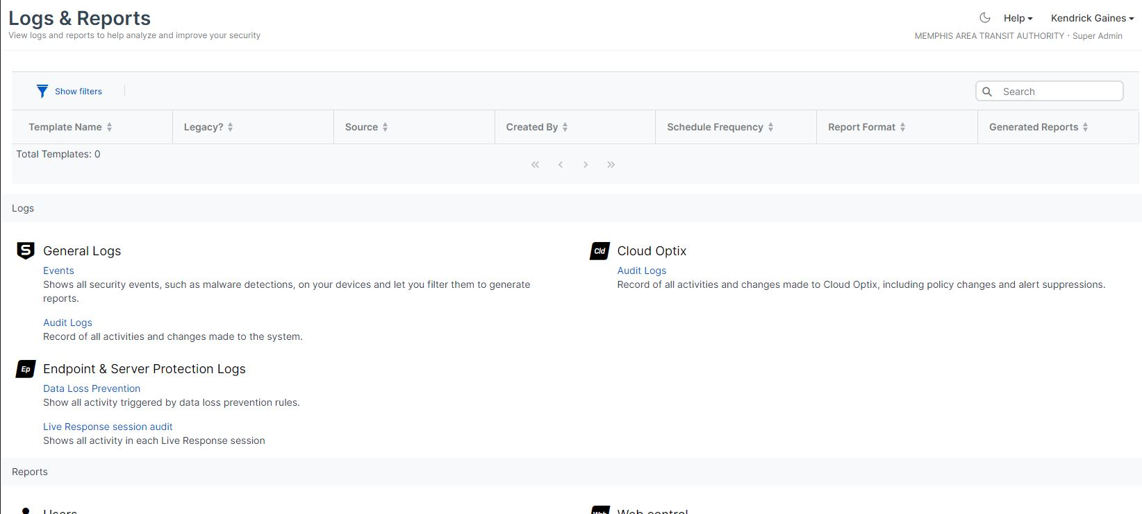
Logs & Reports
Log & Reports have separate links to different type of logs. When a task is performed in Sophos it logs it in event logs. You can view report by filters on the event link. Cloud Optix is not support in Mata environment yet. Audit Logs record of all activities and changes made to the system. Data Loss Prevention show all activity triggered by data loss prevention rules. Live all activity in each live response session.

Slide 13
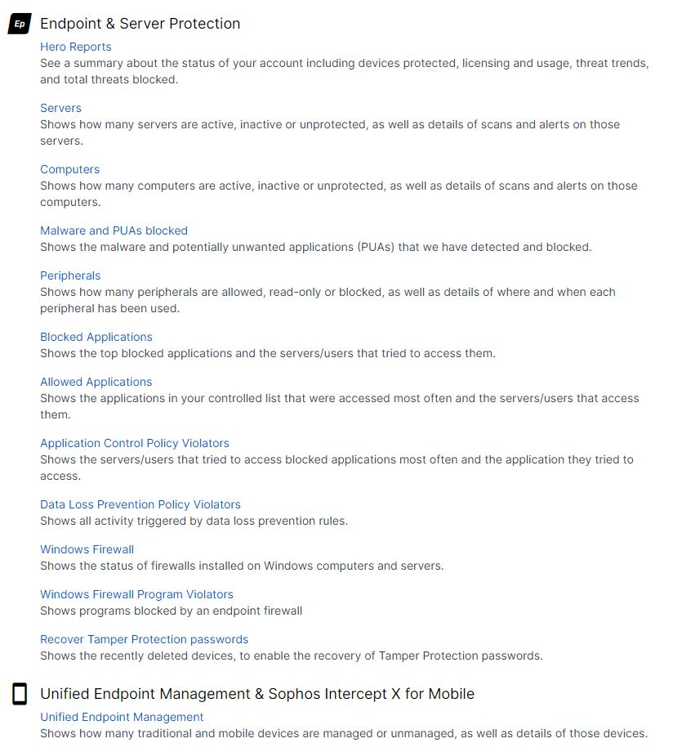
Endpoint & Server Protection
Endpoint & Server Protection has many different reports and logs you can perform listed. Each link takes you to a different tab to filter and read different logs about virus, people, computer, phone and policies. The Unified Endpoint Management & Sophos Intercept X for Mobile reports all phone, and tables managed or unmanaged.

Slide 14
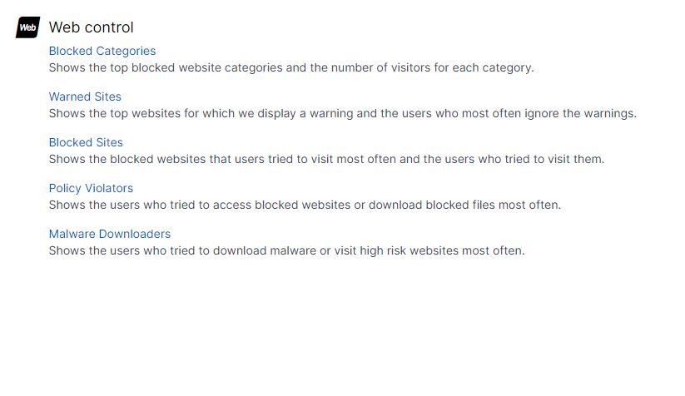
Web Control Reports and Logs
The web control links describe who, what and when someone visit a site where malware is present. These links show blocked websites, people who ignore warning sign about website, number of times a person visit the site and who download the malware to their device.

Slide 15
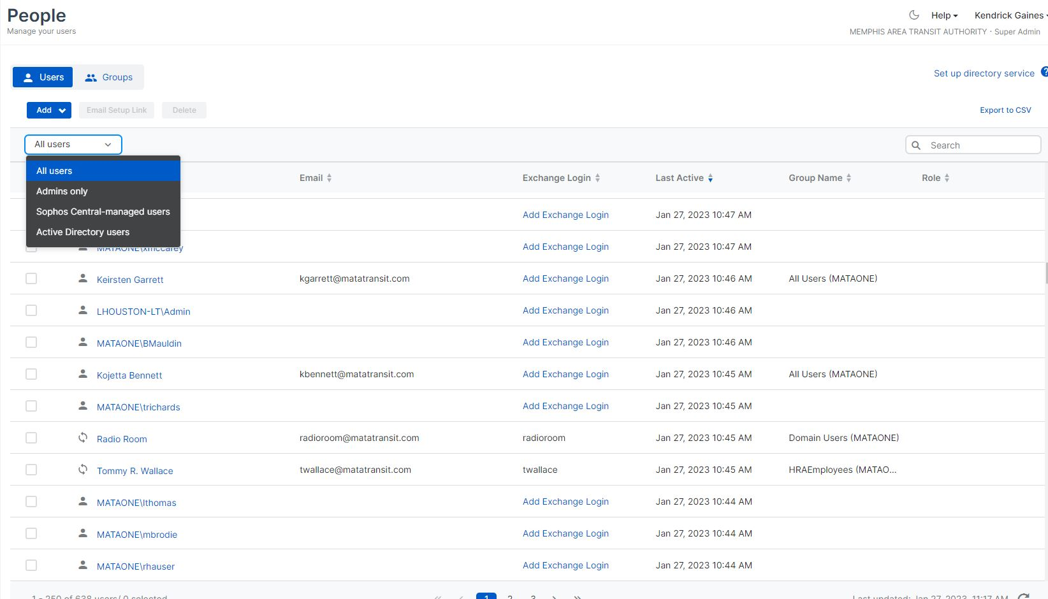
People in Sophos
The people’s tab show users name, email, and last time a user was active. The drop-down tab has four different option to choose to see user details and profile within Sophos.

Slide 16
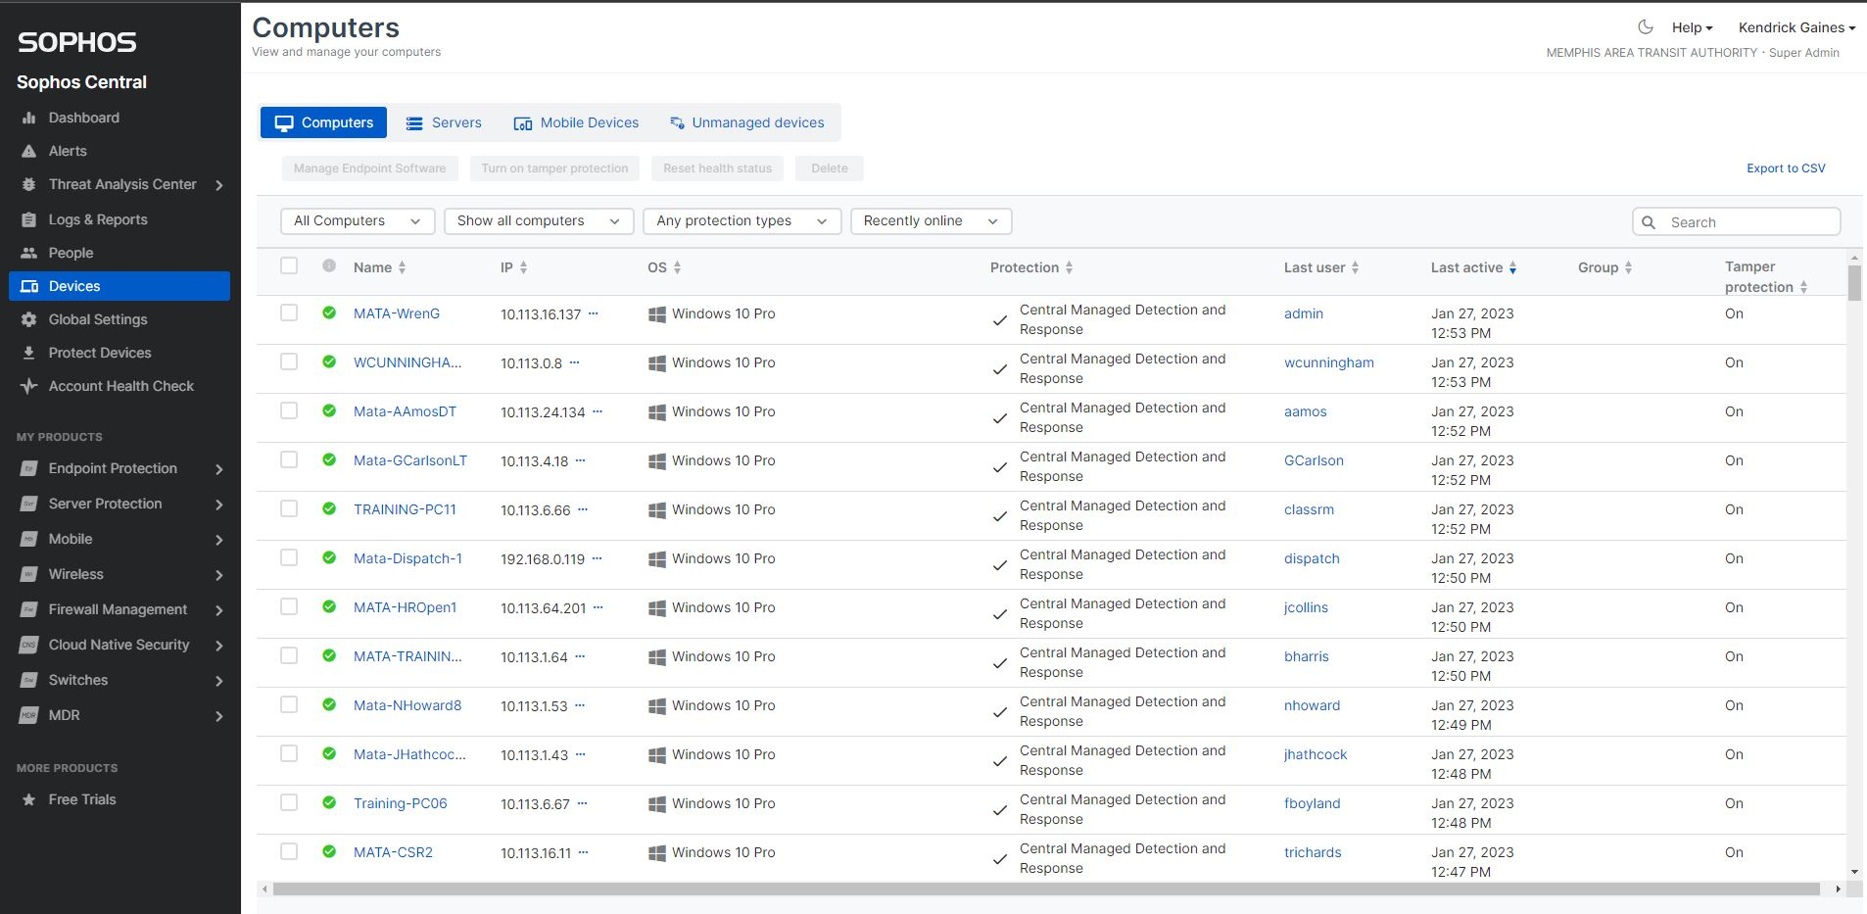
Devices in Sophos
The devices in Sophos are computers, Servers, mobile devices and unmanaged devices. You can click on each tab and display devices under the category. You can also filter the list by show all computers with Sophos installed, Sophos that need attention and the status of that machine. This information can be used to correct any issue with that device or further the investigation with a specific live query.

Slide 17
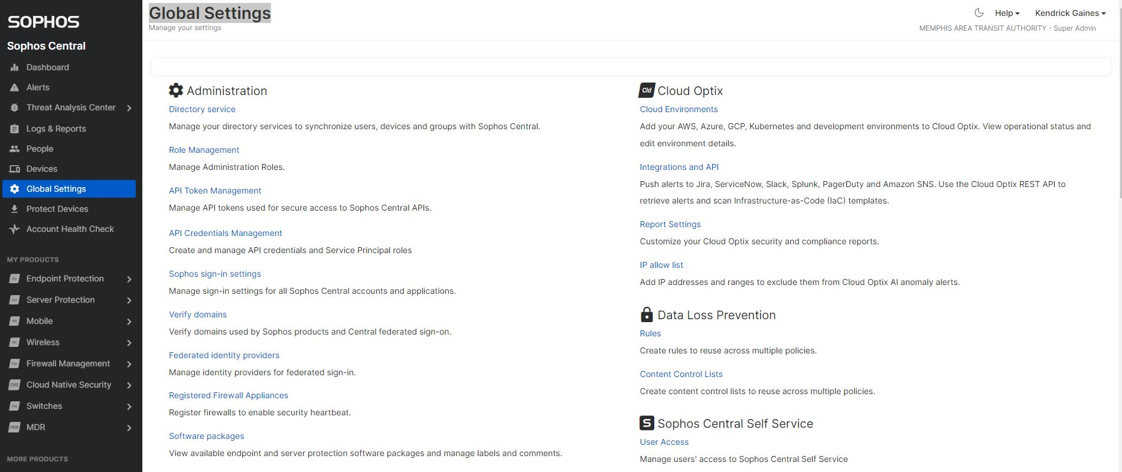
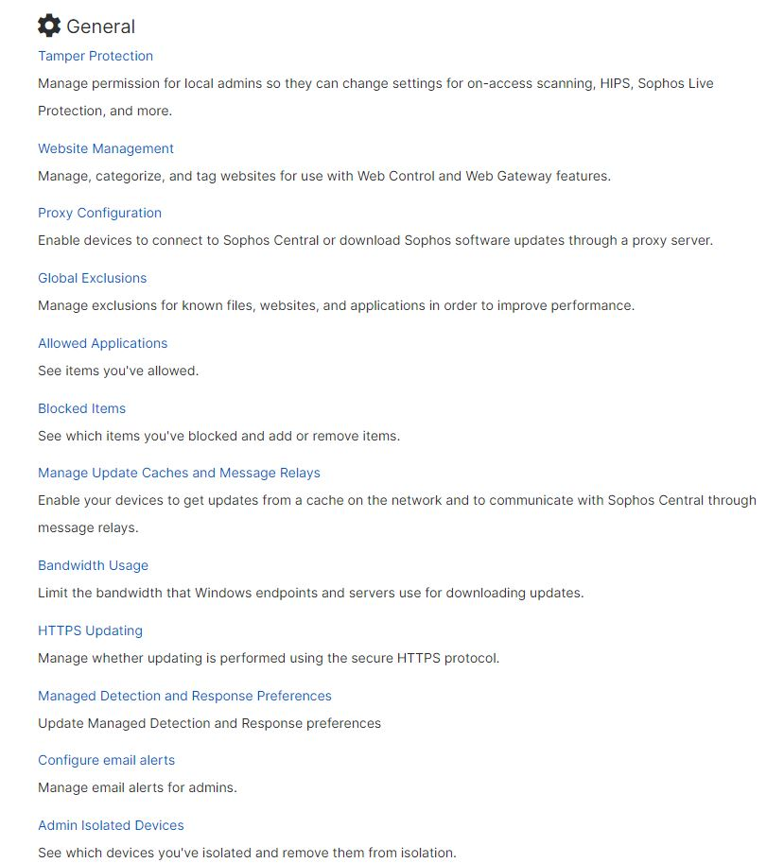
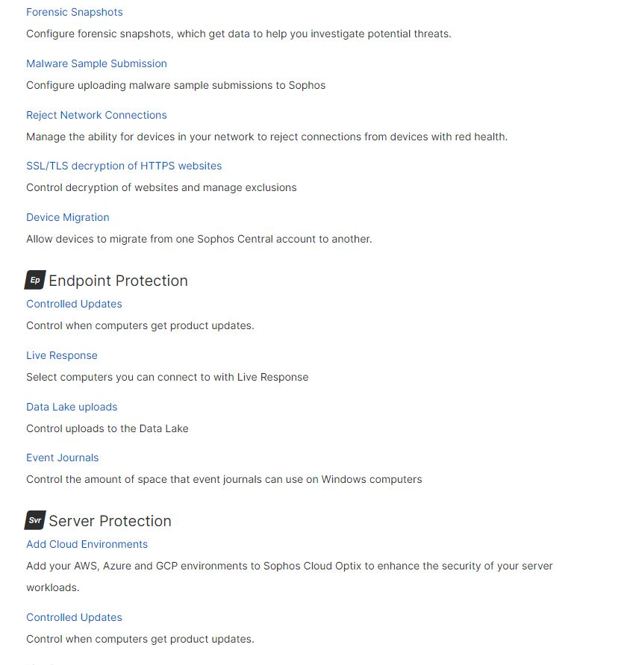
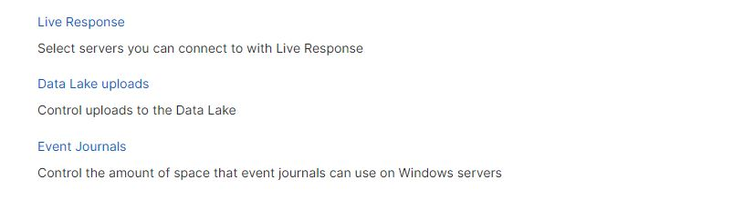
Global Settings
The global settings page is a list of categories where the administrator can configure the Sophos environment. Each link has a description detailing the function of the link. Click the link and configure to address your administration needs.

Slide 18
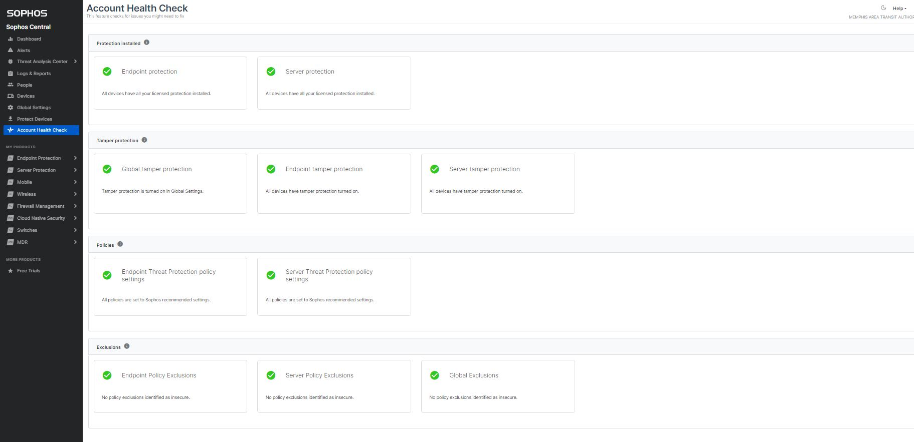
Account Health Check
Account Health Check is a page where an admin can check to see if there are any error within Sophos that need to be fix. The page display errors and the ability to click to go straight to the location of the error.

Slide 19
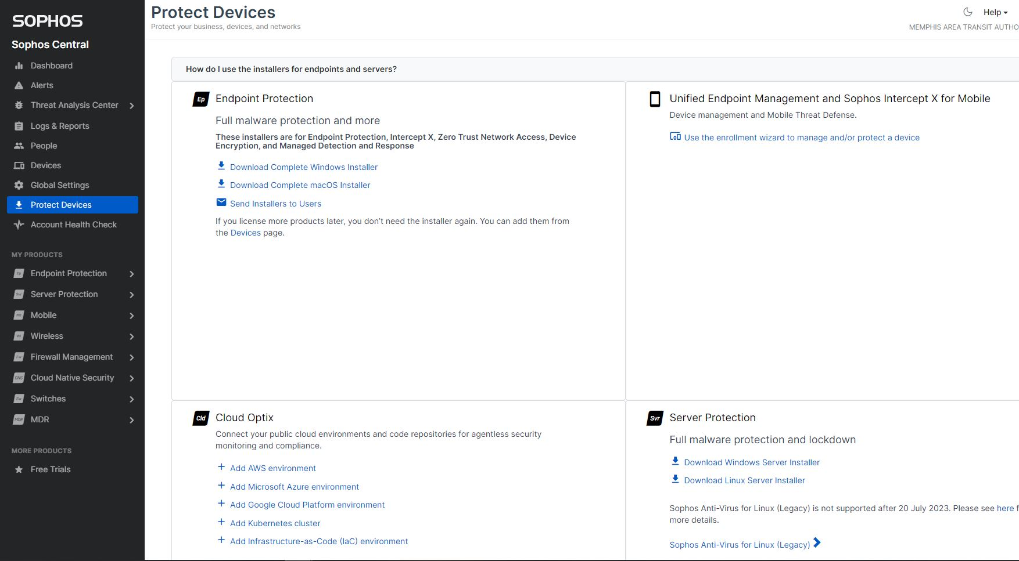
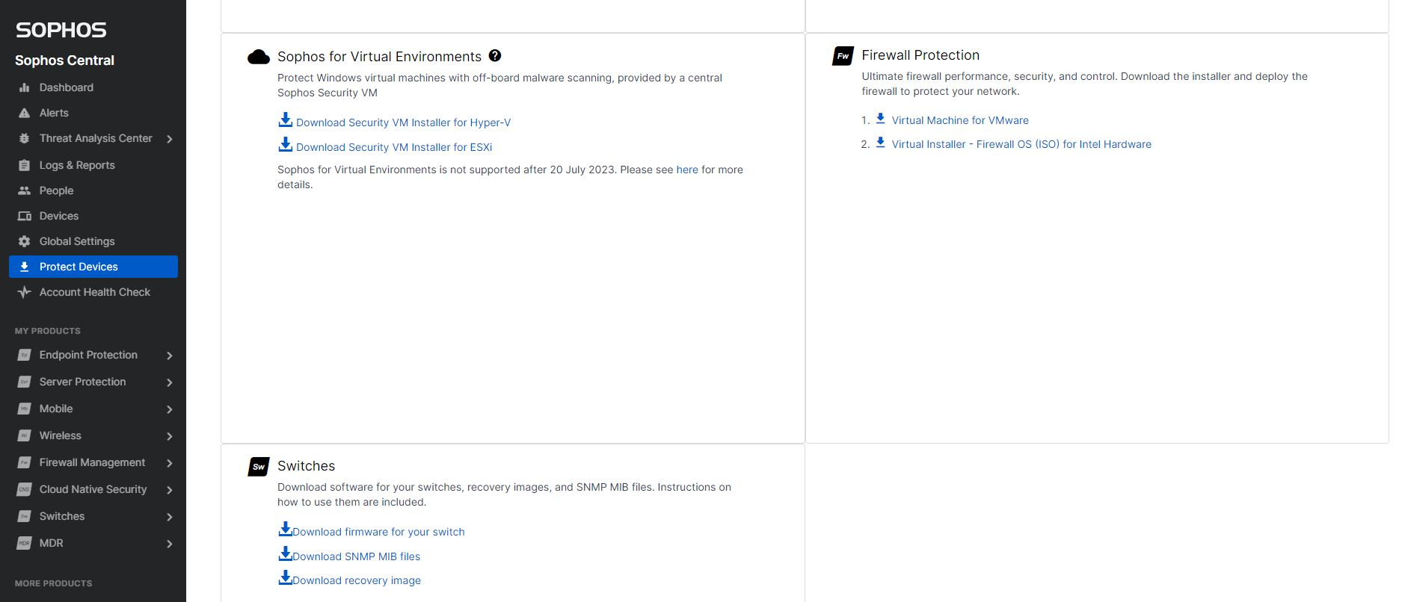
Protect Devices
The Protect Devices page provides software for each device on the network to protect. Each device has its own installer to download from this website. You can even setup Cloud Optix, Hyper-V, ESXI environment and Virtual Firewall from this portal.

